Slide 1
Marijuana Legalization

Slide 2
Current marijuana laws in Florida

Slide 3
Florida MMJ Patient numbers and conditions

Slide 4
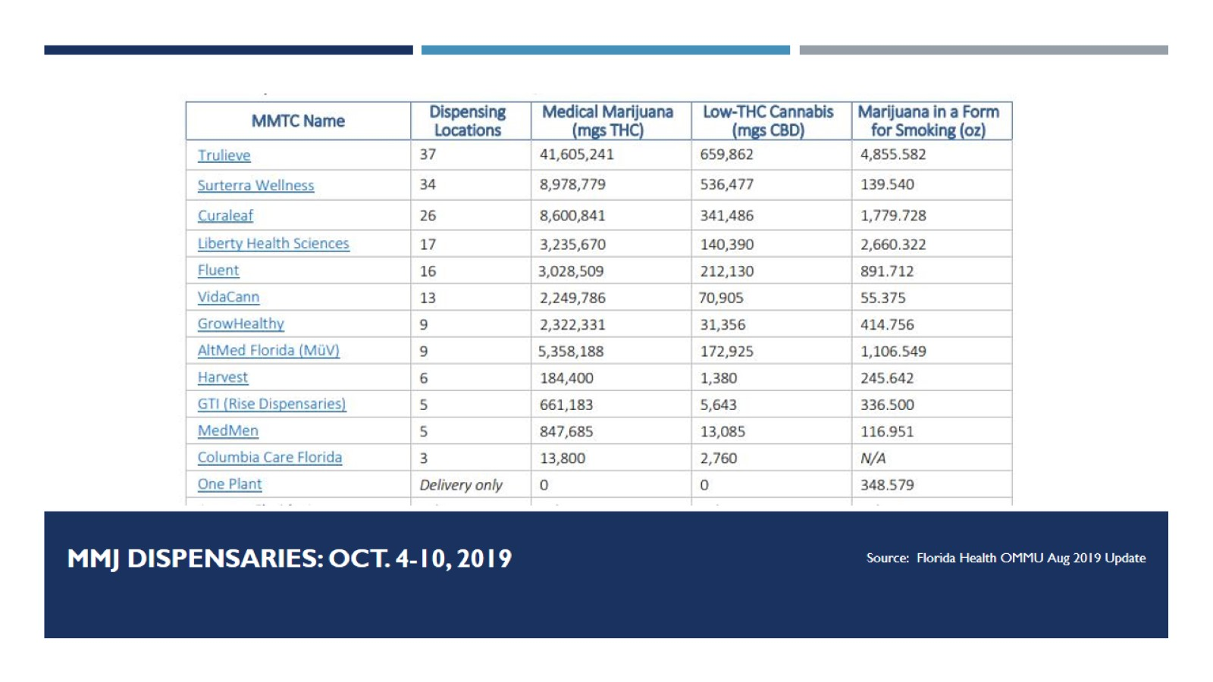
MMJ Dispensaries: Oct. 4-10, 2019

Slide 5
Ounces of Smoked MMJ dispensed August 2-9, 2019

Slide 6
Coming in 2020

Slide 7
Path to the ballot

Slide 8
The unknown - Make It Legal Florida

Slide 9
Marijuana Legalization

Slide 10
Impacts in other states

Slide 11
Colorado MJ Use

Slide 12
Washington MJ Use

Slide 13
Colorado

Slide 14
Colorado

Slide 15
WA- Schools

Slide 16
WA - Schools

Slide 17
Drugged Driving

Slide 18
Colorado

Slide 19
Colorado

Slide 20
Colorado

Slide 21
Colorado

Slide 22
colorado

Slide 23
Washington

Slide 24
Washington

Slide 25
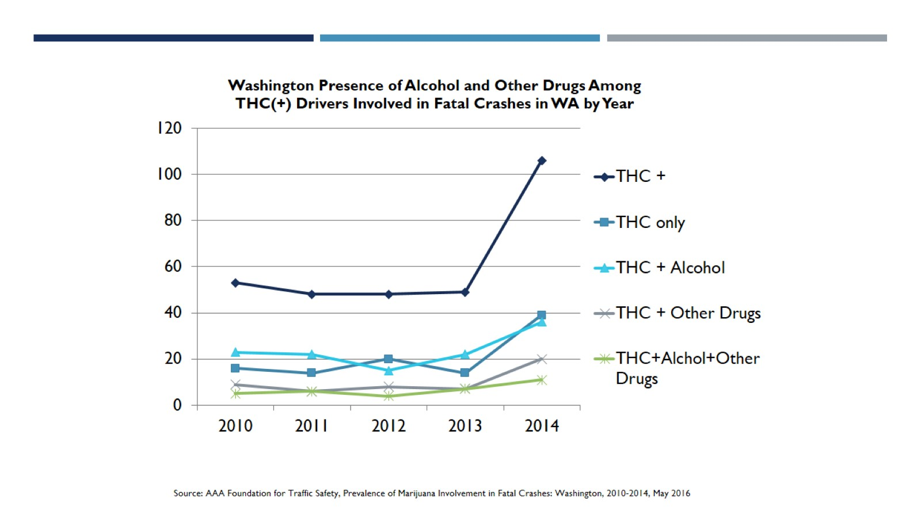
Washington

Slide 26
CO- Diversion (2016)

Slide 27
WA- Diversion (since legalization)

Slide 28
Colorado

Slide 29
Resources

